Slide 1
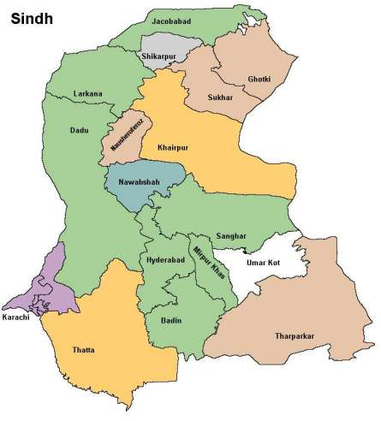

Slide 3
Jcb
Shk
Ght
Lrk
Skr
Ddu
Mpk
Skp
Nwb
Skp
Hyd
Mrp
Umk
Khi
Bdn
Tha
Thr

Slide 4
Jcb
Shk
Ght
Lrk
Skr
Ddu
Mpk
Skp
Nwb
Skp
Hyd
Mrp
Umk
Khi
Bdn
Tha
Thr

Slide 5
16
14
17
15
12
13
10
11
9
8
4
5
6
1
3
2
7

Slide 6
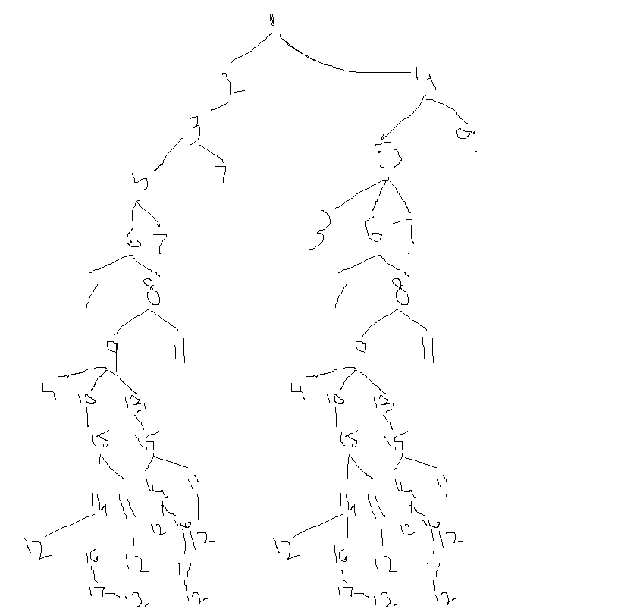
BFS: 1,2,4,3,5,9,7,6,8,11,10,13,15,14,12

Slide 7
16
14
17
12
11
8
4
5
6
1
3
2
7

Slide 8
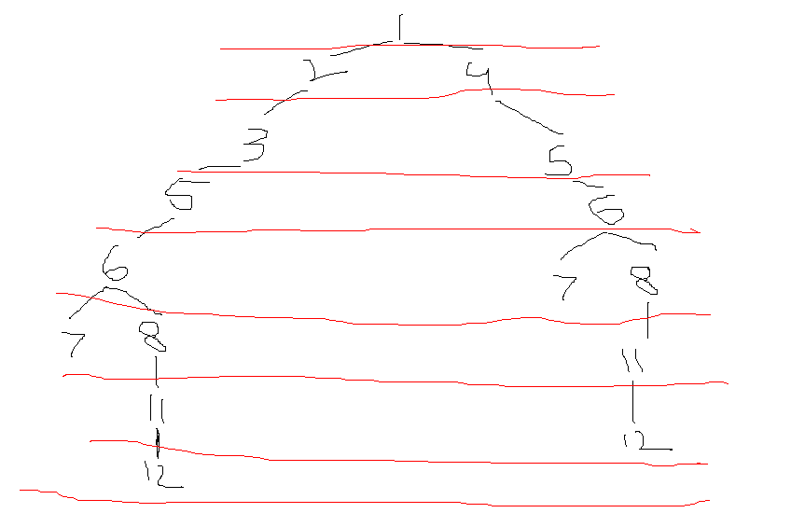
DFS: 1, 2, 3, 5, 6, 7, 8, 11,12
BFS: 1, 2, 4, 3, 5, 6, 7, 8, 11,12

